Slide 1
CS 542 Project Simulate Link State Routing Algorithm.
Professor: Dr. Michael Y. Choi
TAs: Zhidu Yan & Silambarasan Madanakumar
By : Rohan Digambar Gawade
Student ID : A20379951
Seat Number : 29

Slide 2
Link State Routing Protocol
The link state routing algorithm can be applied to the network only if the network topology and the cost of all the links are known.
Dijkstra’s algorithm computes the minimum path cost from a source node to every other node in the topology.
The property of the Dijkstra’s is that its iterative and after the kth iteration of the algorithm, the least cost path are found to the k destination nodes

Slide 3
Link-State (LS) Algorithm (Dijkstra) for Source Node u
Description:
The algorithm takes Source node u as input.
In the Initialization step, the source node is marked as visited indicated by visitedNode[u] = 1.
All the neighbors of u are processed and if there exists a cost between u and neighbor v then it is stored in D(v) else D(v) = ∞
From step 8 to 15 the Dijkstra algorithm finds the shortest path from source node u to all other nodes.
Node w is selected such that visitedNode[w]!=1, that is, it is not visited and has a minimum distance D(w).
After the minimum distance node is found it is added to visited list by making visitedNode[w]=1’
For each neighbor v of w and not visited find the minimum distance from u. The new cost will be D(u,v) or D(w)+D(w,v)
Iterate until all the nodes are visited.
1 Initialization:
2 visitedNode[u] = 1
3 for all nodes v
4 if v is a neighbor of u
5 then D(v) = c(u,v)
6 else D(v) = ∞
7
8 Loop
9 find w such that visitedNode[w] !=1 and D(w) is a minimum
10 add w to visited list by making visitedNode[w] = 1
11 update D(v) for each neighbor v of w and not in N’:
12 D(v) = min( D(v), D(w) + c(w,v) )
13 /* new cost to v is either old cost to v or known
14 least path cost to w plus cost from w to v */
15 until all nodes are visited
Reference: Computer Networking
A Top Down approach

Slide 4
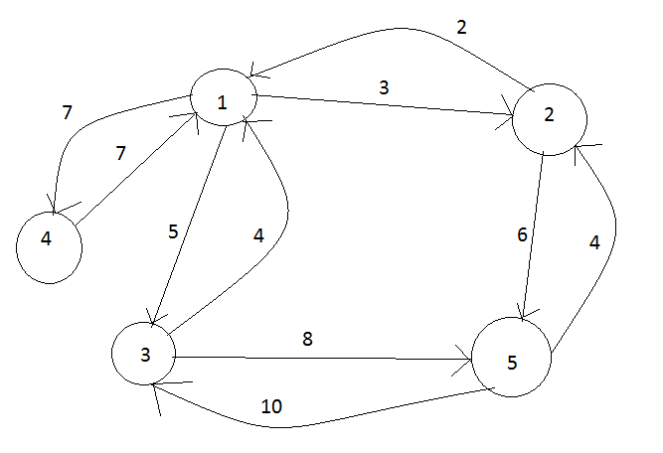
Input Graph
Topology
R1 R2 R3 R4 R5
R1 0 3 5 7 -1
R2 2 0 -1 -1 6
R3 4 -1 0 -1 8
R4 7 -1 -1 0 -1
R5 -1 4 10 -1 0

Slide 5
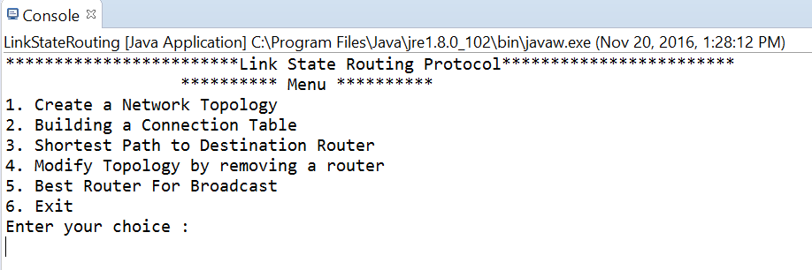
Output: Display Menu for user to choose the option.

Slide 6
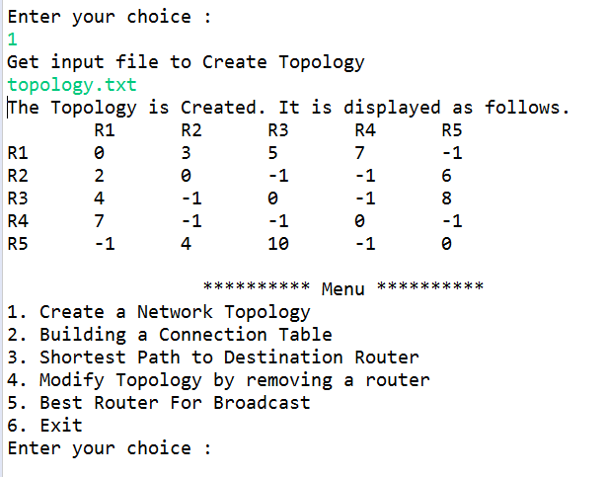
Select Option 1: Create Topology
Description
Reads the network topology from the file and displays the path cost between the routers.
0 indicates cost between the router and itself
-1 indicates cost bet two indirectly connected routers

Slide 7
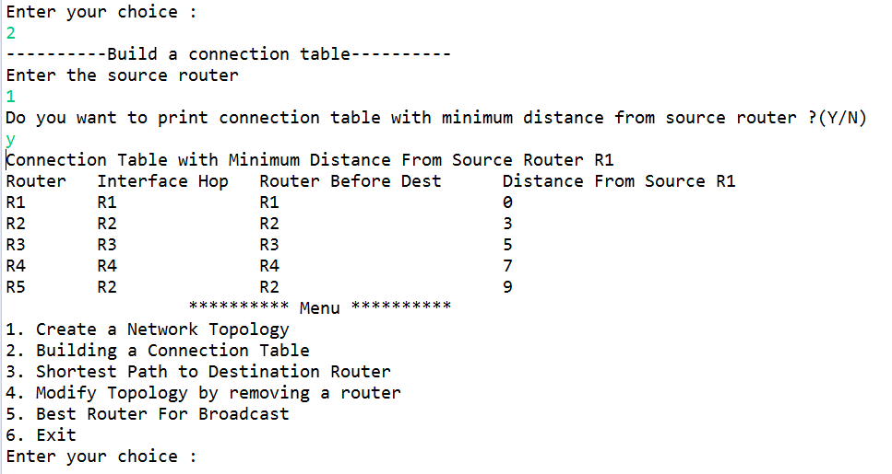
Option 2 : Connection Table
Description
Show the connection table for the source router.
The output displays connection table for router R1.
It displays the interface hop from the source router, Router before Destination router and the minimum cost to other routers from R1 when ‘Y||y’ is given as input after giving source router as input.

Slide 8
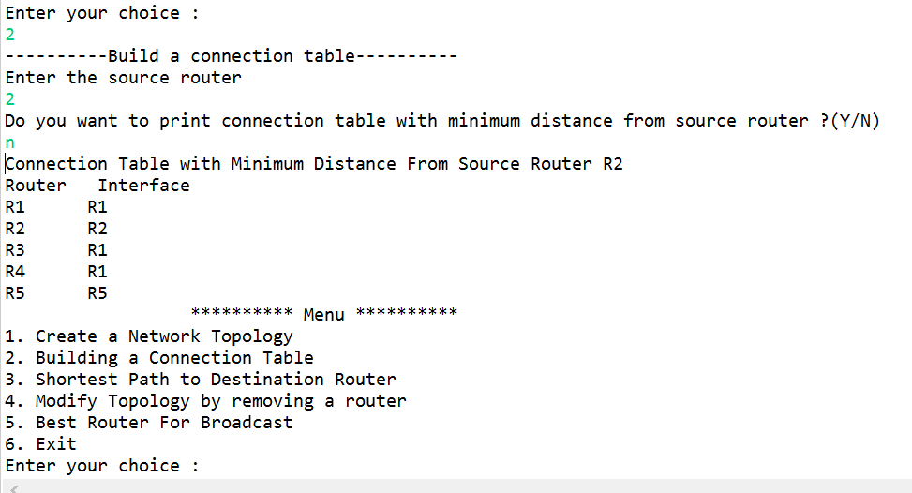
Option 2 : Connection Table
Description
Show the connection table for the source router.
The output displays connection table for router R2.
It displays the interface hop from the source router as we opt not to print minimum distance by passing ‘N||n’

Slide 9
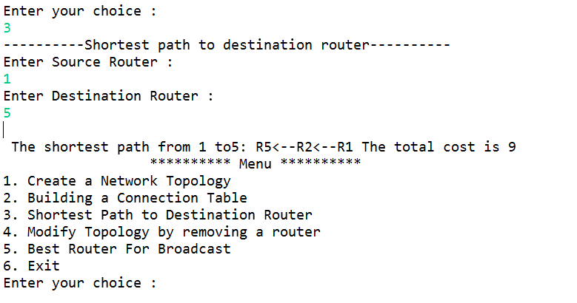
Option 3 Shortest Path Between Source and Destination
Description
The source router is selected as 1
The destination router is selected as 5
We can see the shortest path from R1 to R5 is via node R2.
Therefore the output is
R5<--R2<--R1
As we can see in the slide 6 the cost from R1 to R5 is 9 which is via R2

Slide 10
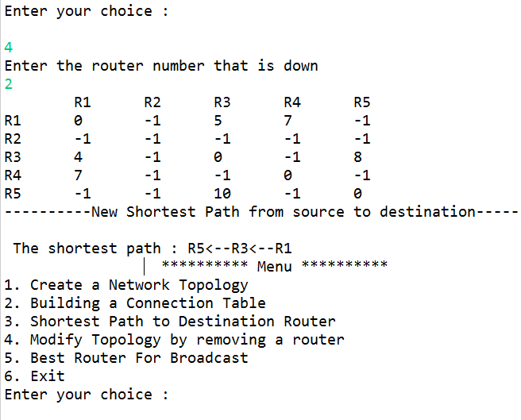
Option 4:Modify topology by removing router
Description
We remove router 2 from the topology. i.e. we make R2 related values in matrix = -1
Now as we can see that since router 2 is down the shortest path from R1 to R5 is recomputed and the shortest path is now traversed through router 3 (R3).
The output is therefore
R5<--R3<--R1

Slide 11
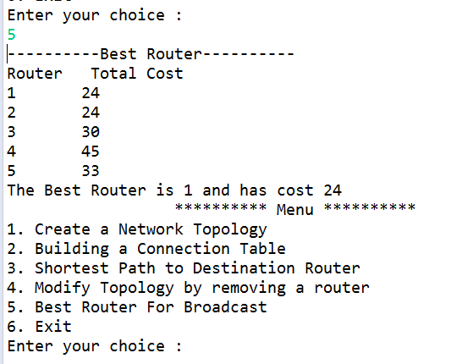
Option 5: Best Router
Description
The router with minimum cost is returned.
The total cost for all routers as source is calculated and the one with minimum value is returned.
Since we have two routers with same value any one of the two will be returned.

Slide 12
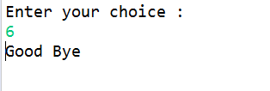
Option 6: Exit

Slide 13
THANK YOU

